Slide 1
What makes a good poll?
Amit Patil, Cade Smiley, and Jonathan Ivey

Slide 2
Central Question
Polling helps parties and individual donors prioritize the races to fund.
Recent polling misses in presidential elections have damaged the credibility of polling.
How can we understand the performance of past polls to evaluate future polls?
In short, what makes a good poll?
Notes:
Cade
Mention that polling is about margins
1 ½ minutes

Slide 3
Overview
Define Central Question
Our Data
Characteristics of Quality Polls
Methodology
Setting
Pollsters
Key Takeaways
Notes:
Amit
½ minute

Slide 4
Our Data
FiveThirtyEight’s Pollster Rating Dataset [1]
1998-2022
Every election for Presidents, Governors, Senators, and Representatives.
Within three weeks of the election.
[1] https://github.com/fivethirtyeight/data/tree/master/pollster-ratings
Notes:
Jonathan
1 minute

Slide 5
Methodology

Slide 6
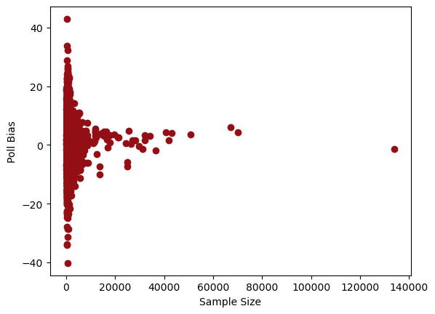
Sample Size
Higher sample size reduces variability.
If n > 4,000, under 12% error.
If n > 7,000, under 10% error.
Notes:
Jonathan
1 minute

Slide 7
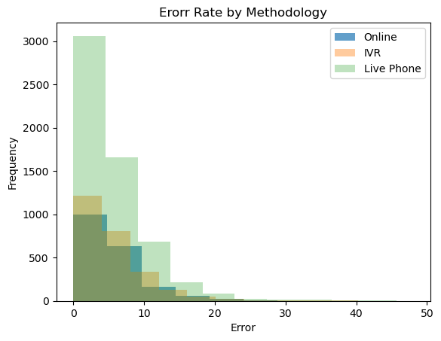
Polling Methods
ANOVA testing shows no difference in error between the three major methods of polling.
Some polls use combinations of these and other methods, like text.
For most common combinations, no statistically significant difference between any methods, except for combined live phone and online polls.
Notes:
Cade
1 ½ minutes

Slide 8
Setting

Slide 9
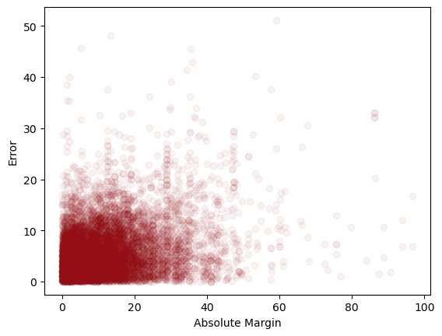
Competitiveness
Closer races don’t give more accurate polls.
Notes:
Jonathan
45 seconds

Slide 10
Location
Polling is more accurate in more important places.
Lowest Mean Error
Georgia
Virginia
Nebraska’s 2nd District
Washington
Colorado
Highest Mean Error
Hawaii
Washington, D.C.
Wyoming
Idaho
North Dakota
Notes:
Jonathan – Don’t forget to explain Nebraska’s district
2 minutes

Slide 11
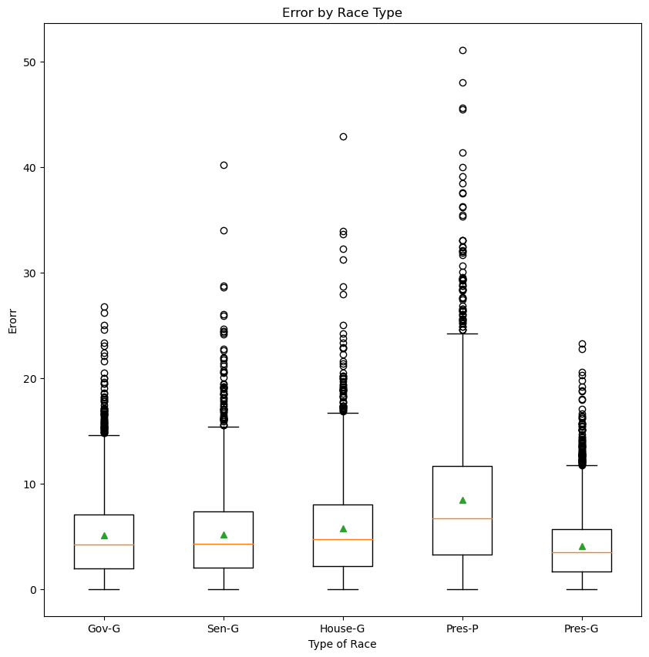
Race Type
Significant differences in error based on type of race being polled.
Presidential general elections tend to have most accurate polling.
Followed by Gubernatorial and Senate races, with no significant difference.
Presidential primaries have least accurate polls.
Notes:
Cade
1 minute

Slide 12
Pollsters
Notes:
Amit

Slide 13
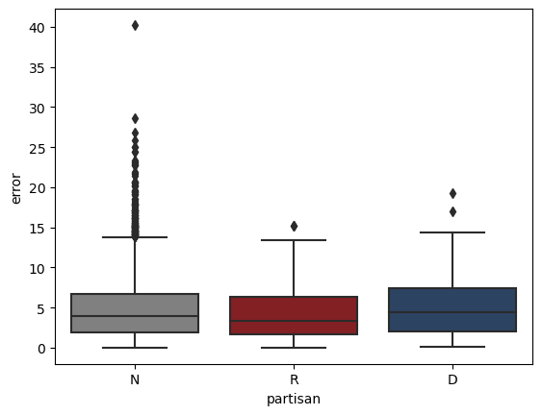
Partisan - Error
The median error in partisan polls is not much different from nonpartisan polls.
Notes:
Amit
30 seconds

Slide 14
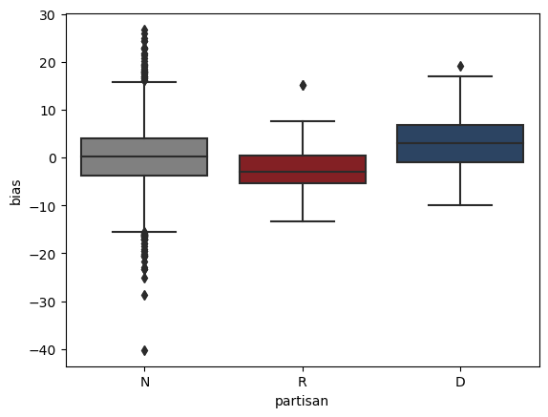
Partisan - Bias
Non-partisan polls have a median bias close to 0.
Republican polls have a median bias that leans Republican, while Democratic polls lean Democrat.
Notes:
Amit
1 minute

Slide 15
Key Takeaways
Notes:
Amit

Slide 16
When evaluating a poll look for…
Large sample sizes
Importance
Partisan Affiliation
Notes:
Amit
1 minute

